Slide 1

Projects Using React.js & Flux
Project 2: GitHub Profile Viewer

Slide 2
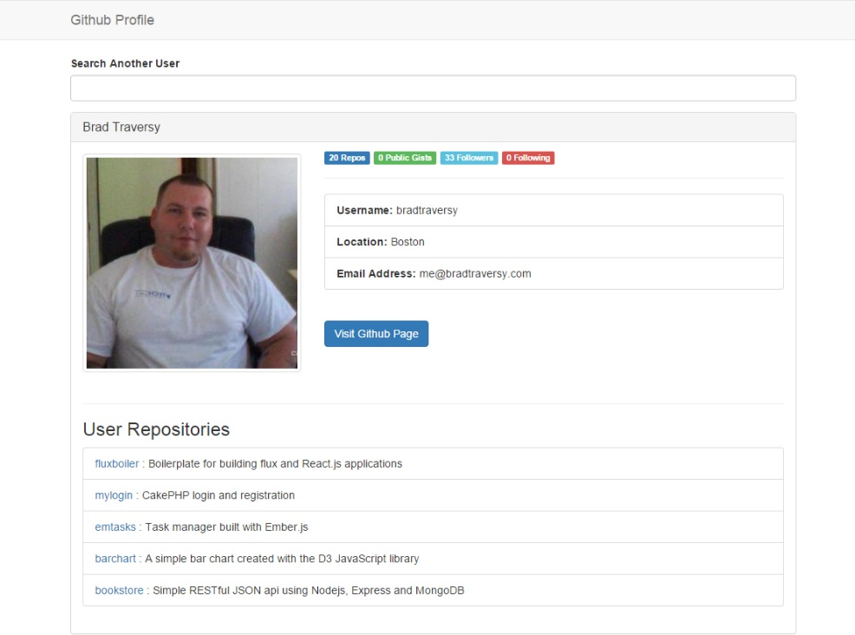
Project Description
An app that will let users search for specific GitHub accounts and display all of the information

Slide 3
Project Lectures
Section Intro
Files & Webpack Setup
Main App Component
Profile Component
RepoList & Repo Components
Search Component

Slide 4
What You Will Learn
How to setup multiple components and nest them
How to install and use Webpack
How to run the Webpack Dev Server
How to working with forms and submission
Working with events

